Slide 1
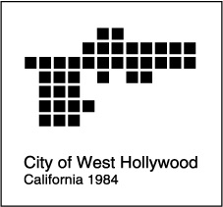
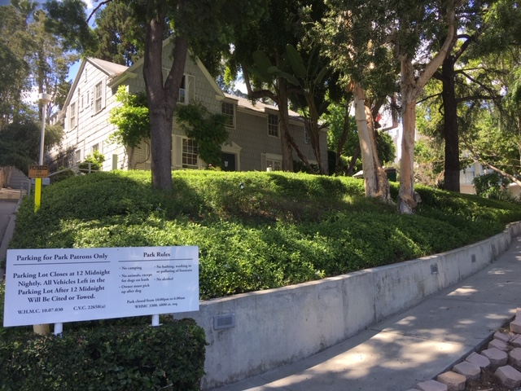
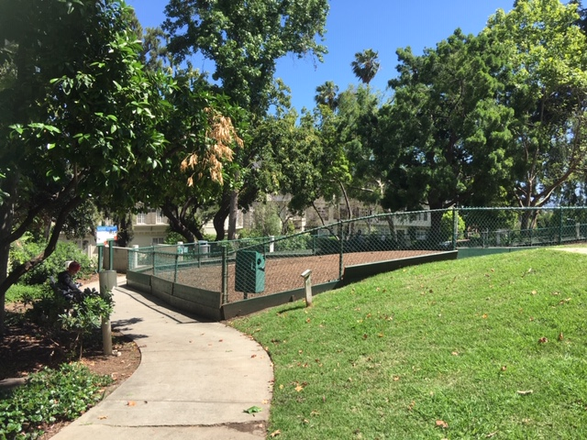
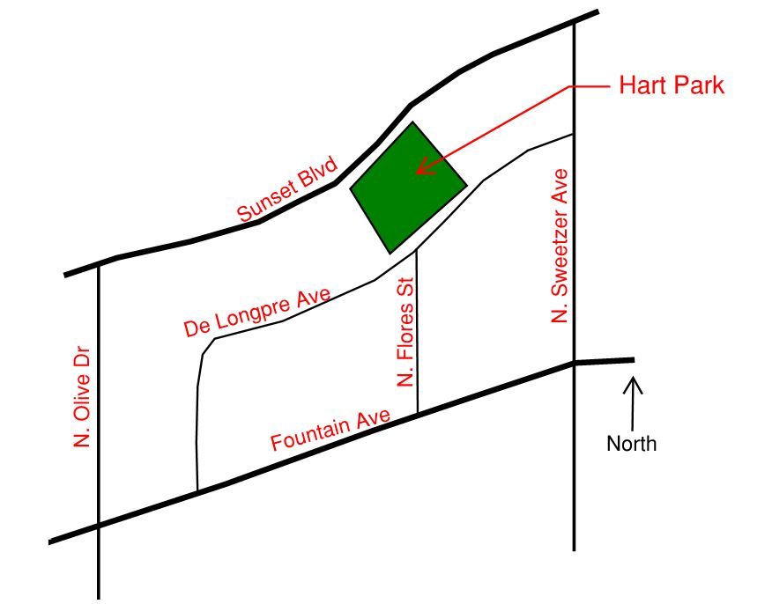
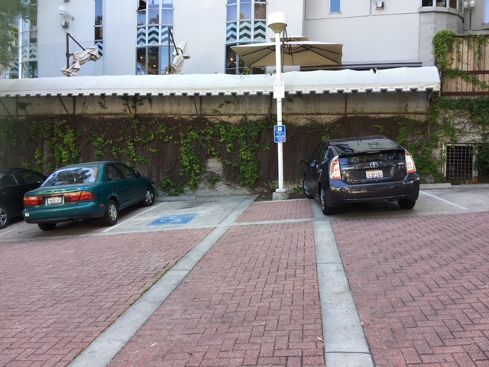
City of West Hollywood
Hart Park Improvement Project
Public Park
Hart Park is a Local Cultural Resource of the City of West Hollywood in the County of Los Angeles.
The grounds offer wonderful outdoor amenities to the public including an AIDS Memorial, off-leash fenced-in dog park area, picnic tables and beautiful landscaping.
A portion of the building is used as a theatrical center by the Actors Studio.
Project Scope
This conceptual phase of design will involve community input events to obtain feedback on desires and concerns for the park improvements. These events will be followed up with community presentations to graphically demonstrate what the improvements will look like and engage community participation to arrive at various design concept ideas.
The primary focus of the improvements is to provide access to the park for all park patrons by upgrading existing parking and ramp locations, improving the dog park surface and amenities, and enhancing security features including lighting.
Improvements and upgrades to the existing buildings will be performed in a separate phase of work.
WeHo
Hart Park!

Slide 2
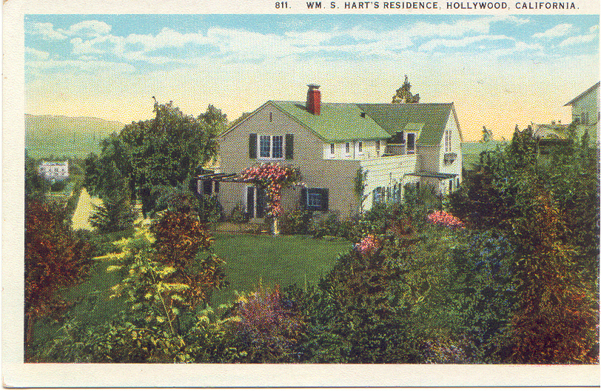

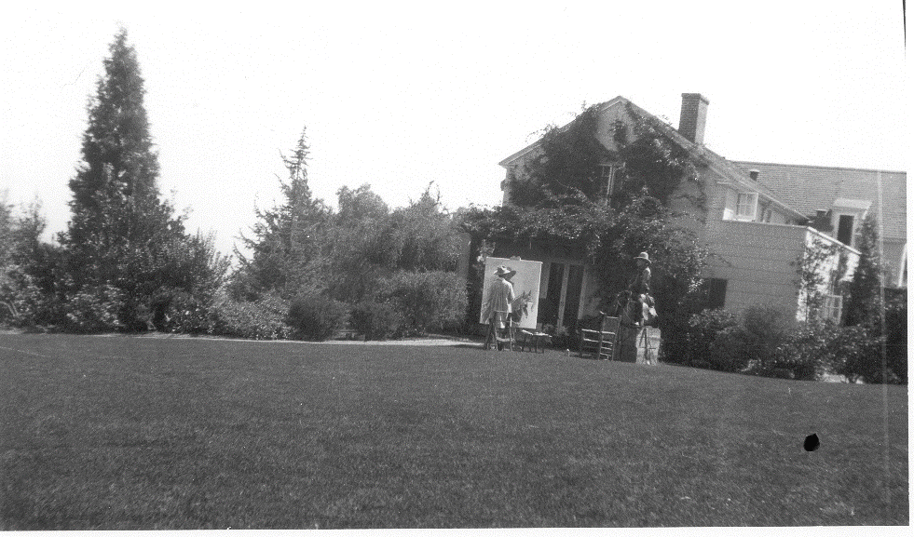
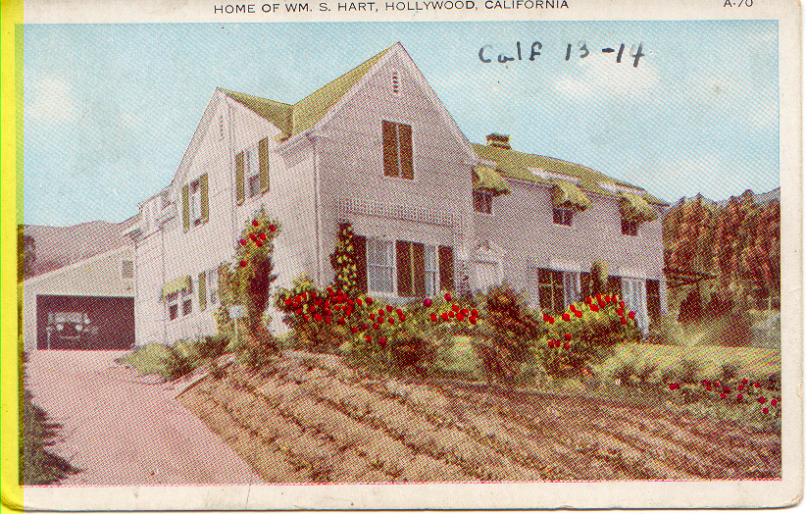
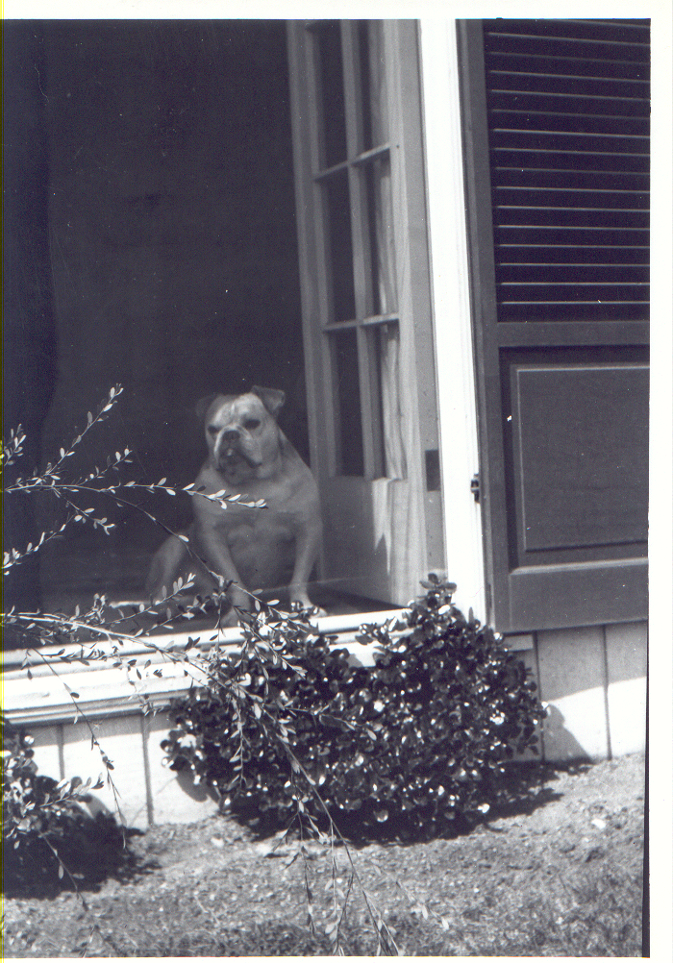
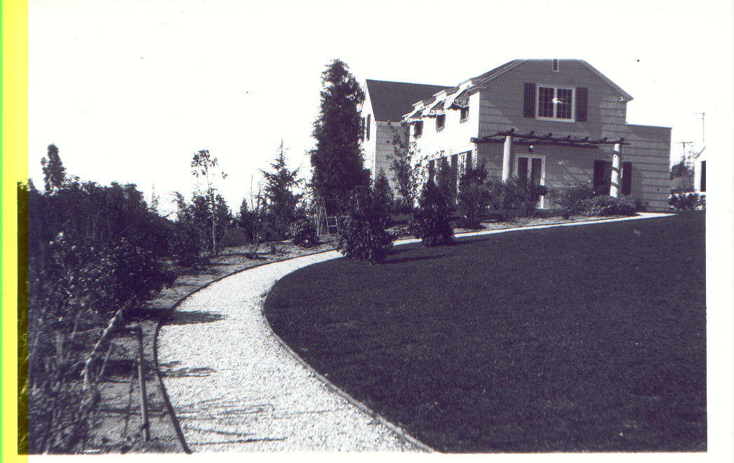
City of West Hollywood
Hart Park Improvement Project
Public Park
Hart Park is a Local Cultural Resource of the City of West Hollywood in the County of Los Angeles.
The grounds offer wonderful outdoor amenities to the public including an AIDS Memorial, off-leash fenced-in dog park area, picnic tables and beautiful landscaping.
A portion of the building is used as a theatrical center by the Studio Actors Guild.
Local Cultural Resource
The building on the property, referred to as Hart House, is one of the few examples of Colonial Revival Style architecture located in West Hollywood.
These buildings, constructed in 1919, were originally the home of silent movie actor William S. Hart who donated the house and property to the City of Los Angeles upon his death in 1944.
The structure is a two level, L-shaped house with a wood shingle exterior and gable roof. The “L” shape is open to the southeast and a square brick chimney projects from the roof on the northern side.
The entrance to the house, on the south façade facing DeLongpre Avenue, is a plain wood paneled door with a Classical plain wood paneled door with a Classical wooden pediment and surrounding molding.
Fenestrations include French doors, paired casements and six over six double sash windows. The windows have molded wood lugsills and the French doors have heavy wood lintels. Second floor windows break the cornice line and punctuate the roof with shed roofed dormers.
The eastern façade features a stone column and wood trellis. There is a one story detached wooden structure at the rear of the property.
WeHo
Hart Park!

