Slide 1

Tenant Basics
The rights and responsibilities of renters in the City of West Hollywood. Part one of a two part series.
2/5/2019

Slide 2

Important Note:
This presentation explains some of the basic provisions of the City of West Hollywood Rent Stabilization Ordinance and California landlord/tenant law.
It is not intended to act as a substitute for legal advice or for reading the law itself.
2/5/2019

Slide 3
Tenant Basics Outline - Part 1
Moving In
Finding an apartment - rent stabilized and not rent stabilized
What to look for before deciding to rent
Application fee, credit check and holding deposit
Signing your lease – What is in it? What does it mean?
Rent amount, security deposit and registration fee pass-through
Registration requirement for rent stabilized units
Living There
Rent payments, rent increases, fee-pass through and pass-through rebate
Maintenance standards
Housing services and parking
Landlord’s right to enter unit
Emergency preparedness
Moving Out
Notice required
Lease obligation
One tenant stays, the other moves out
Settlement of the security deposit
2/5/2019

Slide 4
Finding an apartment
Wanting to live in West Hollywood
Street addresses at www.weho.org
Rental referral list
Rent stabilized units vs. non-rent stabilized units
Disclosure obligation
Both will be market-rate at move-in
Addresses of rent stabilized units at www.weho.org
Is this unit for you?
Location in building – proximity to laundry room, dumpster or other noise makers
Able to get satellite television
Ask about noise and any other concerns you have
2/5/2019

Slide 5
Agreeing to rent
Application and fee for credit check
Prospective tenant typically is asked to complete an application which asks for credit information.
CA law allows a fee of not to exceed $49.12 to do a credit check. Tenant is entitled to a copy.
A reasonable holding deposit is allowed. If tenant backs out of the rental, the holding deposit is usually forfeited. If the landlord refuses to rent because of bad credit, holding deposit should be refunded.
2/5/2019

Slide 6
Leases
Lease is the most important document of the tenancy. Once signed, tenant is obligated to its terms. No time period to change mind.
Sets how much rent is paid, when rent is paid, who can live in the unit and other enforceable rules.
Things to look for:
Is there a grace period for paying rent?
Is there a limit on how many guests are allowed? How long may guests stay?
Are “normal business hours” extended?
Is a move-out notice that is longer than 30 days required?
Must the notice to move-out be concurrent with when rent is due?
2/5/2019

Slide 7
Leases – cont’d.
The following lease provisions are legal:
Requiring renter’s insurance
Not allowing subleases
Requiring keys for unit
No smoking in your unit or common areas
Provisions which violate the law are not legal, even if tenant agreed to them.
Side agreements for housing services are legal, but should be in a separate document.
Once the lease is signed, a landlord cannot make unilateral changes.
2/5/2019

Slide 8
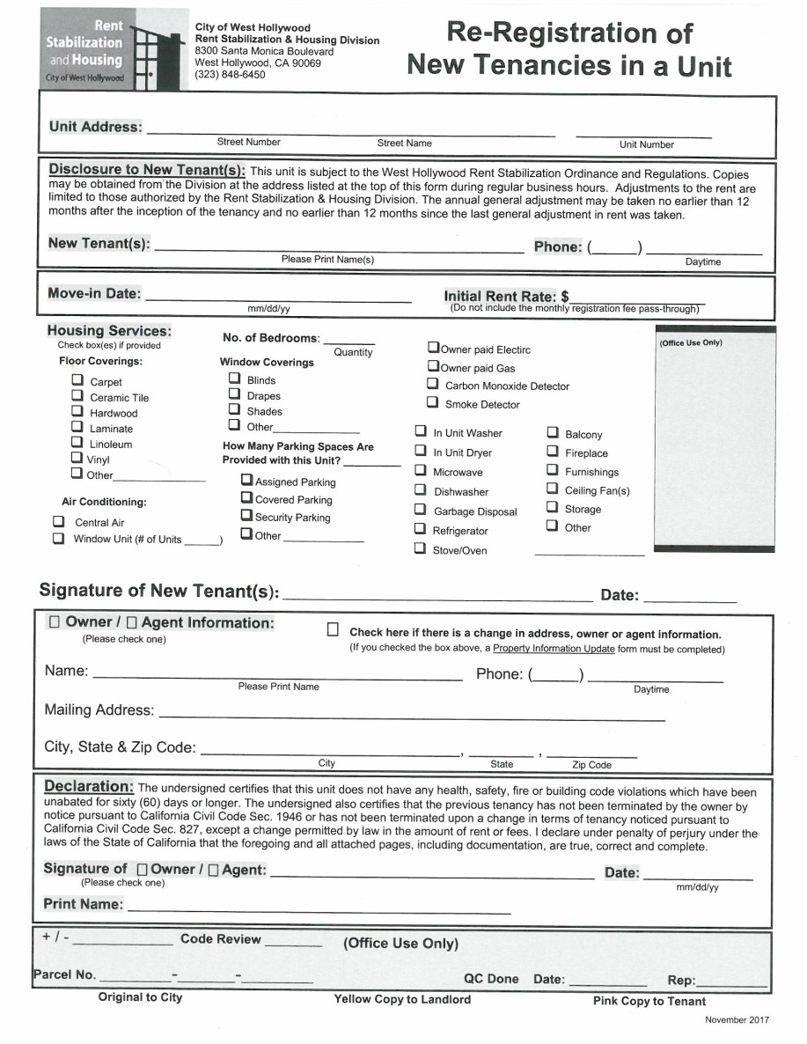
At the start of the tenancy
Landlord collects first month’s rent and a security deposit (e.g. damage deposit, cleaning deposit, key deposit, last month’s rent) not to exceed a total of two months rent for an unfurnished unit.
Deposit may not be increased during the tenancy.
Tenant will be asked to sign a Re-Registration of New Tenancy form. Its purpose is to provide information to the City about the new tenancy.
2/5/2019

Slide 9
Security Deposit Interest
Landlords are obligated to pay tenants interest annually on deposits they are holding.
Interest rate is calculated by taking the regular savings account rate paid by five local banks on July 1, averaging it, and rounding to the nearest one-quarter of one-percent.
This formula has resulted in an interest rate of 0% for deposits held since 2012.
2/5/2019

Slide 10
Moving-in
Moving Van Policy
Obtain a “Residential Moving & Large Vehicle” permit from the Parking Counter at City Hall if you anticipate using a parking space on the street for loading or unloading a moving van or truck. The permit entitles you to reserve a parking space for a vehicle on the street on moving day.
“No Parking” signs received with the permit must be posted at least 72 hours in advance of moving day in order to have parked cars towed.
A permit is not required for the moving van if it will be parked in a driveway or parking lot.
2/5/2019

Slide 11
Moving-in cont’d.
California Department of Consumer Affairs recommends tenants and landlords jointly do a room by room inventory of the rental unit’s condition within three days of moving in.
The Department’s publication “California Tenants” contains a form to use for this purpose (link below).
Keep it, your lease and your copy of the Re-Registration form in a safe place for future reference.
http://www.dca.ca.gov/publications/landlordbook/index.shtml
2/5/2019

Slide 12
Rent payments
Lease states how much, when, to whom and method of payment allowed.
Electronic payments cannot be the sole way the tenant is required to pay rent.
Neither California law, nor the Rent Stabilization Ordinance, provide a grace period for paying rent.
However, the RSO states the rent must be five or more days late before a late fee can be charged, and the late fee is limited to 1%.
The RSO states that the fee for a bounced check may not exceed the amount the landlord’s bank charges the landlord.
2/5/2019

Slide 13
Registration fee pass-through
Landlords are billed an annual Registration Fee for every unit subject to the RSO. This fee pays for the operation costs of the Rent Stabilization program.
One-half of the fee can be passed through to the unit’s tenants, but not as a lump sum. The fee amount passed-through must be prorated over 12 months.
Since July 1, 1993, the fee was $120 per year per unit. The landlord could pass-through $60, making the prorated amount $5 per month for the tenant.
As of July 1, 2017, the fee was raised to $144 per year per unit. The landlord can pass-through $72, making the prorated amount $6 per month.
Because the fee pass-through is not considered “rent” under the Ordinance, it has no impact on the amount or timing of rent increases.
2/5/2019

Slide 14
Registration fee rebate
Tenants who are 62 or older, or disabled, and very low income may apply to the City to get a rebate of the tenant portion of the registration fee.
Tenants may apply for the rebate up to 3 years after their eligibility began. Any amount more than 3 years ago has been forfeited. Here are the current income guidelines:
2017 Maximum Income
1-person household $33,950 or less
2-person household $38,800 or less
2/5/2019

Slide 15
Rent increases
The rent may be increased by the annual general adjustment (AGA) after the tenant has lived in the unit for at least 12 months, or when at least 12 months have passed since the tenant’s last rent increase.
The AGA is calculated by taking 75% of the rise in Los Angeles area Consumer Price Index from May to May every year and rounding it to the nearest one-quarter of one per cent.
The resultant percentage is the AGA as of September 1, and covers all rent increases effective through August 31 of the next year.
ast rent increase.
2/5/2019

Slide 16
Rent increases – cont’d.
AGAs 1985-2016
09/01/18......3.00%
09/01/17…..1.75%
09/01/16…..1.00%
09/01/15......0.75%
09/01/14…..1.25%
09/01/13…..0.75%
09/01/12…..1.25%
09/01/11…..2.25%
09/01/10…..1.25%
09/01/09…..0.00%
09/01/08…..2.75%
09/01/07..…2.25%
09/01/06…..4.00%
09/01/05…..3.25%
09/01/04…..2.75%
09/01/03…..1.50%
09/01/02…..2.25%
09/01/01…..2.75%
09/01/00…..2.25%
09/01/99…..1.75%
09/01/98…..1.25%
09/01/97…..1.00%
09/01/96…..1.25%
09/01/95…..1.75%
09/01/94…..0.75%
09/01/93…..2.00%
09/01/92…..2.75%
09/01/91…..3.50%
09/01/90…..3.75%
09/01/89…..3.75%
09/01/88…..3.25%
09/01/87…..3.50%
09/01/86…..2.50%
09/01/85…..3.00%
Rent increases are available on a “use it or lose it” basis. It cannot be saved for a future date.
California law requires landlords to give tenants a 30-Day written notice to increase the rent.
The City does require landlords to report general adjustment rent increases.
The chart to the right lists every AGA since the Rent Stabilization Ordinance became law on June 27, 1985.
2/5/2019

Slide 17
Maintenance standards
Landlords must:
Paint the interior of units every 4 years, and paint building exteriors every 7 years
Replace carpet, window coverings, linoleum, vinyl floor tile and wall paper if provided every 7 years.
Maintain appliances in good working order.
Comply with applicable Building, Housing and Health Codes.
Onsite manager required for buildings with 16 or more units. Manager must post office hours and be available at least 20 hours per week.
Buildings with five or more units must have an emergency phone number posted in a conspicuous place.
2/5/2019

Slide 18
Housing services
Housing services are landlord-provided services including, but not limited to, utilities, parking, storage, elevator service, laundry room, gardening, common recreational facilities, janitorial service, and any other benefits, privileges or facilities provided to tenants.
Housing services provided at move-in, or added later, must be maintained, or the tenant’s rent must be reduced.
Parking provided on or after January 1, 2004, is an inseparable part of the rented premises, and the landlord can not remove it during the tenancy unless the tenant consents to the removal in writing.
2/5/2019

Slide 19
Landlord’s right to enter unit
Governed by California Civil Code §1954
Reasons for entry:
1) emergency;
2) to make necessary or agreed upon repairs;
3) to show the unit to prospective tenants or buyers;
4) to conduct initial inspection before tenant moves out;
5) when tenant has moved or abandoned unit.
Landlord must give “reasonable” written notice before entry, except when unit is for sale. Typically 24 hours is considered reasonable.
Landlord does not need tenant’s permission. Landlord is informing tenant of the planned entry. Entry must take place during “normal business hours” which can include weekends if the lease says so.
2/5/2019

Slide 20
Get to know your neighbor
While no law requires anyone to know others who live in the building, there are a lot of reasons why it is smart to do so.
In any event, the first interaction with someone else should not be a negative one.
There are limits to what a landlord can do when it comes to noise and other inconsiderate behavior.
Knowing your neighbor before a problem arises will likely result in a solution more quickly.
2/5/2019

Slide 21

Emergency preparedness
After a major disaster, in all likelihood electricity, gas, water and telephones will not be working.
City services will be impacted.
Prepare to be self-sufficient for at least three days
Create an emergency supply kit and a disaster plan.
2/5/2019

Slide 22
What to put in your emergency kit
Emergency supplies may be stored in a plastic container or a backpack and should be checked once a year for expired items.
Supply kit suggestions:
Food – ready to eat canned food for at least three days, but seven to ten days is preferable
Water – one gallon per person per day
First Aid Kit
ABC type fire extinguisher
Flashlight with extra batteries
Portable radio with extra batteries
Blankets, clothing, shoes
Cash
Personal items – medication, eyeglasses, etc.
Tools, non-electric can opener
Whistle
Map of area
Sanitation supplies
Important documents
Items for your pets
2/5/2019

Slide 23
Make a disaster plan
Suggestions for your disaster plan:
Pick a meeting place for you and family, friends, etc. in case you are separated
Choose an out-of-state contact as a “check-in contact”
Discuss the types of disasters that could occur and how to be prepared
Discuss what to do if advised to evacuate
Practice what you have discussed
Plan how the neighborhood could work together after a disaster
Consider how you could help neighbors who have special needs, such as elderly or disabled persons
Make plans for child care in case parents can’t get home
Post emergency telephone numbers by every phone
2/5/2019

Slide 24
Notice to move out
State law requires a 30-day written notice when moving out.
Can be given at any point during the month unless lease states otherwise.
Tenant is obligated for rent through the notice period, unless the unit is rented to someone else sooner.
Only a deposit called “last month’s rent” can automatically be applied towards the last month’s rent. If the rent was increased, tenant pays the difference between the amount held and the current rent.
Note: If the tenant is breaking a lease, the tenant is obligated to pay rent for the duration of the lease, or until the unit is rented to someone else. The only time when outside circumstances allow a lease to be broken is for someone in the military who receives a transfer, or someone who is a victim of domestic violence or sexual assault.
2/5/2019

Slide 25
Some tenants stay, some go
Typically the lease makes tenants jointly and separately responsible for the entire rent.
There is no change in the rent until all of the initial parties on a lease move out.
The remaining tenant on a lease has the right to get a replacement tenant.
The landlord has the right to require that a replacement roommate meet the same standards he or she normally uses when finding a tenant.
The landlord may not unreasonably withhold consent for the replacement.
Typically the replacement roommate will be a subtenant and not named a co-tenant on a new lease. This is up to the landlord.
2/5/2019

Slide 26
Security deposit settlement
Your landlord is obligated to settle the security deposit only when the unit is turned over vacant.
When there is a replacement roommate, usually the deposit is settled between the one who moved-out and the one who is moving-in, or assumed in its entirety by the remaining tenant.
After receiving notice that the tenants are moving, the landlord must notify them in writing that they have the right to request a walk-through with the landlord before moving.
The purpose of the walk-through is to give the tenants an opportunity to perform some of the repairs. The walk-through is not the final word on deposit deductions. The landlord can make additional deductions, if necessary.
2/5/2019

Slide 27
Security deposit settlement – cont’d.
California law specifically allows the landlord to use a tenant’s security deposit for four purposes:
• For unpaid rent;
• For cleaning the rental unit when the tenant moves out, but only to make the unit as clean as it was when the tenant first moved in;
• For repair of damages, other than normal wear and tear, caused by the tenant or the tenant’s guests;
• If the lease or rental agreement allows it, for the cost of restoring or replacing furniture, furnishings, or other items of personal property (including keys), other than because of normal wear and tear.
2/5/2019

Slide 28
Security deposit settlement – cont’d.
Deposit must be settled within 21 days of tenant moving out.
Should include an itemization of what has been deducted, along with receipts for expenses over $120.
If the work necessary cannot be completed within 21 days, the landlord must make a good faith estimate of what it will cost and can deduct the estimate from the deposit. Within 14 days after the work is completed, the landlord must provide a statement of the actual cost and refund any additional amount owing.
The RSO requires the landlord to pay any deposit interest owed together with the settlement of the tenant’s security deposit.
2/5/2019

Slide 29
Legal Resources
Bet Tzedek Legal Services – 323-549-5841
BY APPOINTMENT ONLY
Website: www.bettzedek.org
3250 Wilshire Blvd., 13th Floor
Los Angeles, CA 90010-1509
Legal Aid including representation in evictions court.
Coalition for Economic Survival (CES) – 213-252-4411
Website: www.cesinaction.org
Plummer Park – 7377 Santa Monica Blvd.,
West Hollywood, CA 90046
Wednesday 7 p.m. and Saturday 10 a.m.
Legal advice on a walk-in basis..
Eviction Defense Network – 213-385-8112
Website: www.evictiondefensenetwork.org
Guaranteed representation for LA County tenants facing eviction as long as they come in a week before the trial. Sliding scale fee, but no one turned away for lack of funds.
Los Angeles County Bar Association – 213-243-1525
Lawyer Referral and Information Service
Website: www.lacba.org
This referral service is a nonprofit public service that allows members of the public to find a qualified attorney and get general information about common legal issues. Accessing information and getting a referral to an attorney is free.
Santa Monica Courthouse – 310-255-1963
Website: www.lasuperiorcourt.org/locations
(search for Santa Monica Court)
1725 Main Street
Santa Monica, CA 90401
( Hours: 8:30am–10:30am & 1:30pm-3:30pm)
This court has jurisdiction over all West Hollywood unlawful detainer (UD) cases. Small Claims.
Small Claims Court Advisors – 213-974-9759
Website: http://www.dca.lacounty.gov/
They will give you advice about the procedures for filing Small Claims cases in court, including security deposit issues.
Disability Rights California – 800-776-5746
Website: http://www.disabilityrightsca.org
They advance and protect rights of Californians with disabilities.
Housing Rights Center – 800-477-5977
Website: http://www.hrc-la.org
They support and promote hair housing through education, advocacy and litigation.
.
2/5/2019

Slide 30
Other Resources
Fire Department Non-Emergency (323) 262-2111
Website: https://www.firelacounty.gov
Housing Rights Center (800) 477-5977
Website: http://www.housingrightscenter.org
LA Department of Water and Power (800) 342-5397
Website: http://www.myladwp.com
Prevention Bureau (Smoke Detectors) (310) 358-2380
Website: http://www.lacofd.org
Sheriff’s Department (310) 855-8850
Website: http://www.lasd.org/lasdservices.html
Vector Control (mosquitoes, rodents) (310) 915-7370
Website: http://www.lawestvector.org
AQMD (Asbestos, etc.) (800) 288-7664
Website: http://www.aqmd.gov (909) 396-2327
Beverly Hills Water (310) 285-2467
Website http://www.bhsaves.org
City Building & Safety Dept. (323) 848-6320
Website: http://www.weho.org
City Code Compliance (323) 848-6516
Website: http://www.weho.org
Environmental Health (LA County) (213) 351-7896
Website: http://lapublichealth.org/eh/
2/5/2019

Slide 31

Contact Us:
Rent Stabilization and Housing Division
West Hollywood City Hall
8300 Santa Monica Boulevard
West Hollywood, California 90069
Phone: 323-848-6450
Fax: 323-848-6567
E-mail: RSH@weho.org
2/5/2019

