Slide 1

HOW EVICTIONS WORK: Rules for Landlords and Property Managers
City of West Hollywood
Rent Stabilization & Housing
RSO Building Blocks

Slide 2
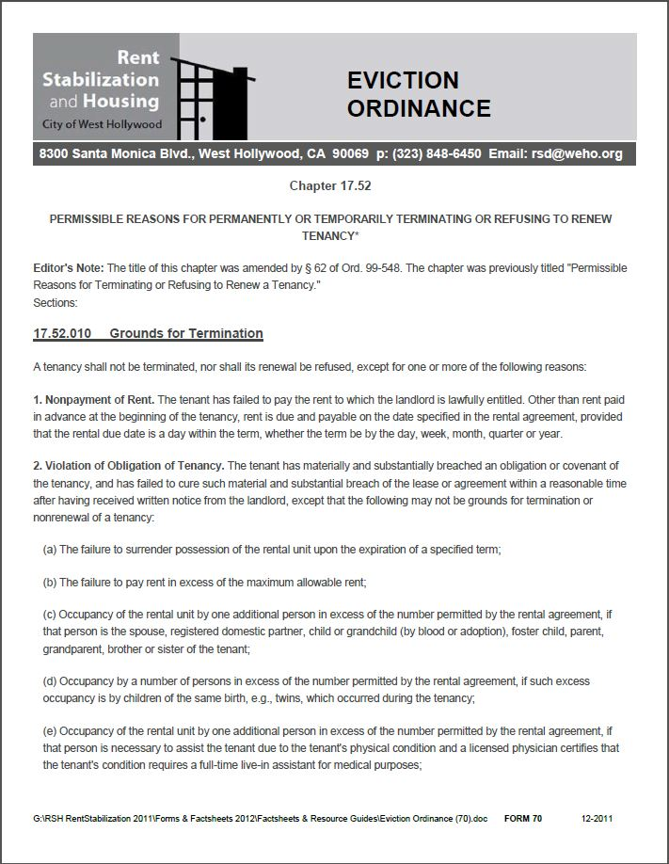
Evictions
For additional information regarding Evictions, please reference :
RSO Chapter 17.52: Permissible Reasons For Permanently or Temporarily Terminating or Refusing To Renew Tenancy
or
Form 70: Eviction Ordinance
Hot Topics
Grounds For Termination
(17.52.010)
Relocation Fees
( 17.52.020)
Retaliation
(17.52.040)
Ellis Act

Slide 3
Grounds for Termination (17.52.010)
A tenancy shall not be terminated, nor shall its renewal be refused, except for one or more of the following reasons :
Nonpayment of Rent
Violation of Obligation of Tenancy
Surviving Tenant
Nuisance
Illegal Use
Refusal to Renew Lease
Refusal to Provide Access
Subtenant
Resident Manager or Employee
Pre-existing Tenant Before Becoming Resident Manager
Temporary Absence from Principal Residence
Owner or Relative Occupancy
Corrections of Violations
Foreclosure
Withdrawal of Residential Rental Structure From Rental Market
Transfer to a Different Unit
Inclusionary Housing Units
Demolition of Rental Units Owned by Certain Organizations in Order to Construct Low and Moderate-Income Housing
Renter’s Insurance

Slide 4
Relocation Fees
(17.52.020)
(a). Generally. When a relocation fee is required by this title, the landlord must pay a relocation fee to the tenant simultaneously with the notice.
Each household is entitled to one relocation fee. Household Relocation Fee Types are based on:
1.) Unit Size
2.) Being a Qualified or Lower-Income Tenant
Please see, Form 96: Income Limits/Relocation Fees/ Relocation Counseling Fees for relocation fee details
(b). No Waiver. A tenant cannot waive his or her right to receive a relocation fee required by this chapter; however, if a tenant does not vacate his or her rental unit by the deadline specified in a valid no-fault termination notice and if the landlord has not granted an extension, the tenant forfeits the relocation fee and must repay the fee to the landlord.
(c). Fees Reviewed Annually. The City Council shall review the fees periodically.

Slide 5
Retaliation
(17.52.040)
If the dominant intent of the landlord in terminating a tenancy or refusing to renew a tenancy is retaliation against the tenant for exercising his or her rights under this title, and if the tenant is not in default as to the payment of rent, the landlord may not terminate the tenancy or refuse to renew the tenancy or cause the tenant to quit involuntarily. In an action to recover possession of a rental unit, proof of the exercise by the tenant of rights under the law within six months prior to the alleged act of retaliation shall create a rebuttable presumption that the landlord’s act was retaliatory.

Slide 6
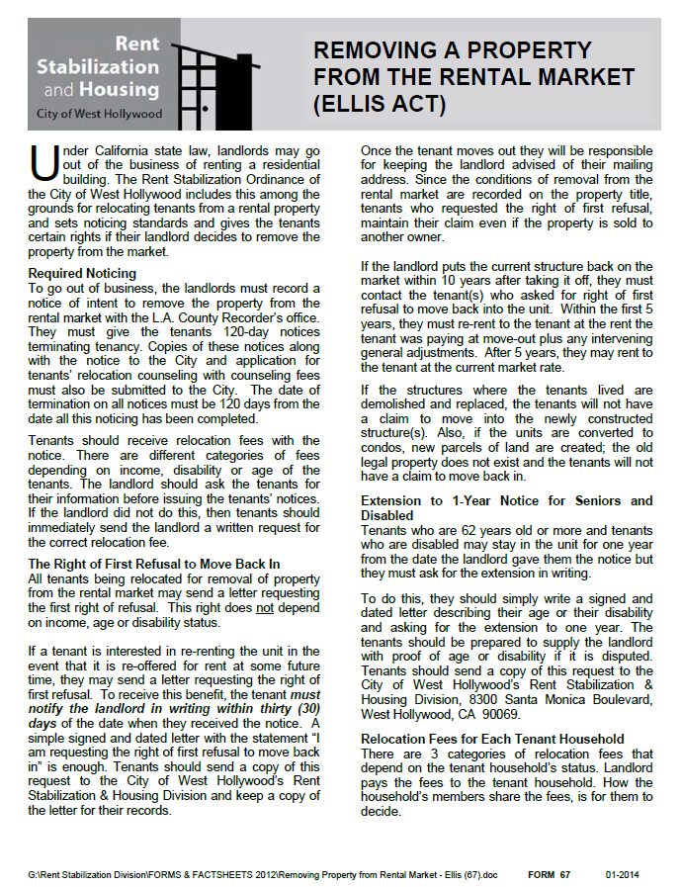
Ellis Act (Removing A Property From The Rental Market)
Under California state law, landlords may go out of the business of renting a residential building. The Rent Stabilization Ordinance of the City of West Hollywood includes this among the grounds for relocating tenants from a rental property and sets noticing standards and gives the tenants certain rights if their landlord decides to remove the property from the market.
Important Ellis Factors to Consider:
Required Noticing
The Right of First Refusal to Move Back In
Extension to 1-Year Notice for Seniors and Disabled
Relocation Fees for Each Household Unit
Requesting the Relocation Fees
Private Civil Settlements: Are They Okay?
For additional information regarding the Ellis Act, please refer to:
Form 67: Removing A Property From The Rental Market (Ellis Act)
California Civil Code Section 7060 – 7060.7
Form 67: Removing A Property From The Rental Market (Ellis Act)

Slide 7
Eviction Resource Information
Rent Stabilization Housing
Form 1: Ellis Packet
Form 2: Owner Occupancy Packet
Form 65: Owner/Relative Occupancy No-Fault Relocations
Form 67: Removing A Property From The Rental Market (Ellis Act)
Form 70: Eviction Ordinance
Form 73: Relocations Following Foreclosures in Condominiums and Single Family Properties
Form 96: Income Limits / Relocation Fees / Relocation Counseling Fees
Guide To Rent Stabilization
Website
(www.weho.org) - City of West Hollywood - Rent Stabilization Housing – Evictions
(www.ca.org) - Government Code Section 7060-7060.7 (Ellis Act)
Rent Stabilization & Housing Division
8300 Santa Monica Blvd, West Hollywood, CA 90069
Phone: (323) 848-6450
Email: rsd@weho.org

