Slide 1
Tenants 101
The rights and responsibilities of renters in the City of West Hollywood
2/5/2014

Slide 2
Important Note:
This presentation explains some of the basic provisions of the City of West Hollywood Rent Stabilization Ordinance and California landlord/tenant law.
It is not intended to act as a substitute for legal advice or for reading the law itself.
2/5/2014

Slide 3
Types of Residential Rental Units in the City
Rent Stabilized
New Construction July 1, 1979
Single Family Home
Condominium
Inclusionary
Section 8
Government HACoLA
Non-Profit WHCHC
Not Applicable
Not Applicable
2/5/2014

Slide 4
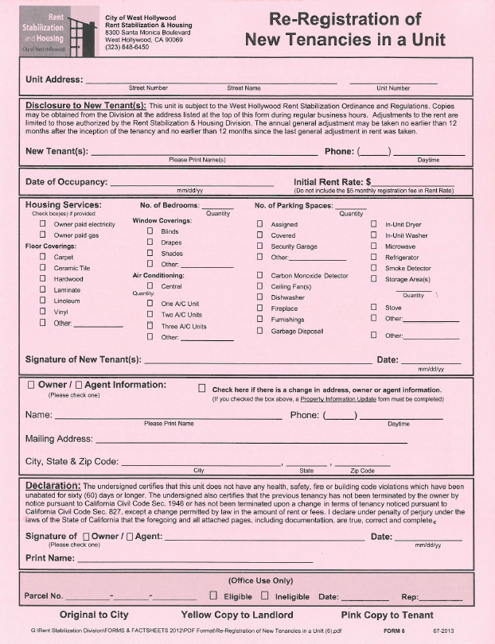
WeHo Rentals: At the Start of the Tenancy
Landlord required to meet habitability standards set in State law
Municipal Code requires disclosure of the unit’s rent stabilization status
Rent and housing services can be whatever the market will bear under California vacancy decontrol
Landlord may charge additional $5 per month as pass-through of registration fees
Re-registration required for new tenancies under rent stabilization
2/5/2014

Slide 5
Lease/Rental Agreement
Governs the tenancy
Sets the amount of rent and date it is due date
Lists landlord and tenant obligations and restrictions
Must contain address where legal process can be served
Renewed on a monthly basis when rent is paid/accepted
Clauses which violate the law are not enforceable
After the start of the tenancy, landlord may not unilaterally change the terms, then evict, unless the tenant agreed to the change in writing
Tenants can get a copy of rental agreement from landlord once a calendar year pursuant to Civil Code §1962(a)4
2/5/2014

Slide 6
Rent Increases & Fees
30-day notice required pursuant to State law – may be given at any point in the month
Rent increase may not exceed the percentage of the general adjustment allowed on the effective date
First rent increase – at least 12 months after move-in
Subsequent rent increases—at least 12 months after the previous rent increase
No increase in security deposit allowed after move-in
Payment of interest required on amount held as deposit
Late fee limited to 1% and only after the rent is 5 or more days late
Bounced checks–-landlord may charge no more than what bank charged the landlord
2/5/2014

Slide 7
Maintenance Standards
All units maintained in accordance with Building, Housing and Health & Safety Codes
Those covered by RSO:
  Unit and common area interior paint every 4 years
  Unit and common area carpet, window coverings, wallpaper, vinyl floor tile, linoleum every 7 years
  Exterior paint every 7 years
  All provided appliances maintained in good working order
  Buildings with 16 or more units must have a resident manager on-site who is available for office hours—20 per week.
  Buildings with 5 or more units must have an emergency phone number posted
2/5/2014

Slide 8
Housing Services
Housing services are landlord-provided services including, but not limited to, utilities, parking, storage, elevator service, laundry room, gardening, common recreational facilities, janitorial service, and any other benefits, privileges or facilities provided to tenants.
Housing services must be maintained, or the tenant’s rent must be reduced
Parking provided on or after January 1, 2004, is an inseparable part of the rented premises, and the landlord may not remove it during the tenancy unless the tenant consents to the removal in writing.
2/5/2014

Slide 9
Dealing with Problems
First, contact landlord or landlord’s agent, preferably in writing, and ask that the problem be resolved
Contact the appropriate government agency to inspect and cite for code violations
Use California Civil Code §1942, the repair and deduct remedy WARNING: Be sure to follow the rules carefully, or the owner might be able to evict for non-payment of rent
Resolve through mediation. It is a voluntary process that typically requires good faith to be successful
For units under the RSO, file for a Rent Hearing
2/5/2014

Slide 10
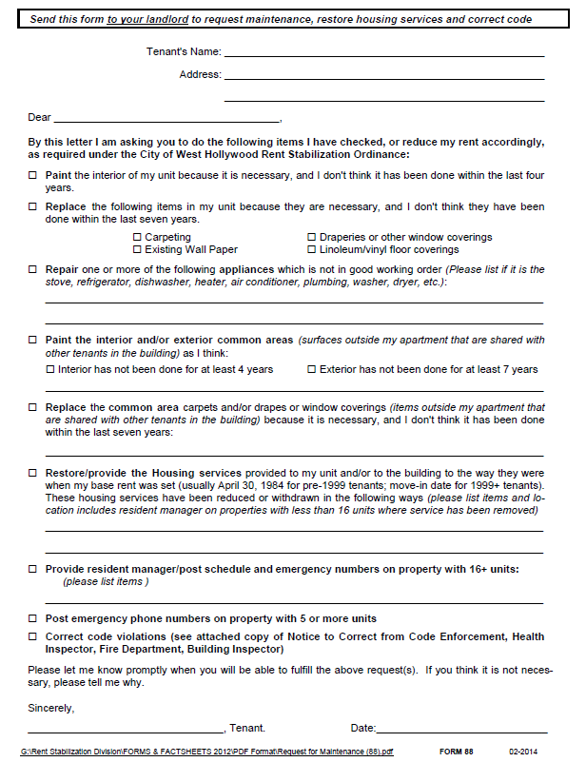
Rent Adjustment Hearings
Before filing, give a written request to the landlord for the needed maintenance or restoration of housing services
File for hearing after 30 days, or after landlord has indicated work will not be done or services will not be restored
Make your case to the hearing examiner, but time period for required maintenance is presumed to have passed
Hearing Examiner issues written decision ordering rent reductions which remain in effect until the work is done or services restored
Form 88
Request For Maintenance/Restore Housing Services/Correct Code Violations
2/5/2014

Slide 11
Landlord’s Right to Enter Unit
Governed by California Civil Code §1954
Reasons for entry:
  1) emergency;
  2) to make necessary or agreed upon repairs;
  3) to show the unit to prospective tenants or buyers;
  4) to conduct initial inspection before tenant moves out
  5) when tenant has moved or abandoned unit
  Landlord must give “reasonable” written notice before entry, except when unit is for sale. Typically 24 hours is considered reasonable.
  Landlord does not need tenant’s permission. Landlord is informing tenant of the planned entry. Entry must take place during “normal business hours” which can include weekends if the lease says so.
2/5/2014

Slide 12
Roommates & Additional Residents
Lease restrictions regarding the number of occupants are enforceable, except one additional person who is a close family member, spouse or registered domestic partner may move in.
No additional rent is allowed for an additional person
Tenants may get a replacement roommate when someone moves out and someone stays. Landlord may require replacement tenant to meet certain standards, but may not unreasonably withhold consent.
Important note: Be careful when finding a roommate. Subtenants have the same eviction protections under the RSO as tenants. A 30-day notice to move is not enforceable. There must be a just cause to terminate the roommate’s tenancy. If the roommate refuses to leave, the only way to force them out is by going to court.
2/5/2014

Slide 13
Evictions and Relocations
The permissible reasons to terminate or refuse to renew a tenancy are listed in WHMC §17.52 . They fall into two groups: “just cause” evictions and “no fault” evictions
Just cause evictions occur when the tenant has done something wrong. Examples are:
  Not paying the rent
  Violating a valid clause in a lease or rental agreement (e.g. getting a pet when none is allowed, exceeding the number of residents in the agreement)
  Refusing to provide the landlord access to the unit
  Creating a nuisance
  Engaging in illegal activity
  Eviction process is governed by State law and is designed to move forward without the tenant’s cooperation. The unlawful detainer is filed in Superior Court with a judge or jury making the eviction determination.
2/5/2014

Slide 14
Evictions and Relocations – cont’d
No fault evictions occur when a landlord is allowed to force a tenant to move even though the tenant has done nothing wrong. The RSO strictly limits the circumstances under which no fault evictions are allowed
Examples of no fault evictions are:
  Owner occupancy, or occupancy by a close relative of the owner
  Foreclosure on a tenant-occupied single family home or condominium
  Correction of violations
  Withdrawal of rental units from the rental market, sometimes called an “Ellis” eviction. Rules dictated by California law.
  Tenants evicted under a no fault provision of the RSO are given 60 days, 120 days or 1 year to move, depending on circumstances and the basis of the eviction. Relocation fees must be paid when the notice to move is served.
2/5/2014

Slide 15
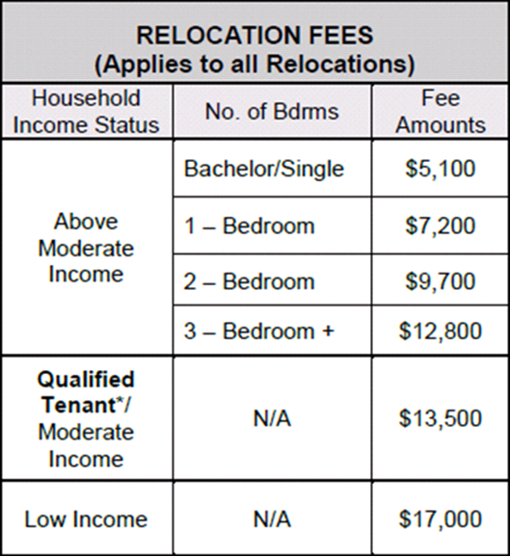
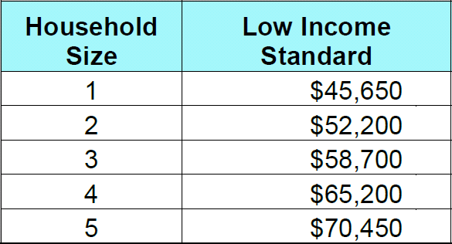
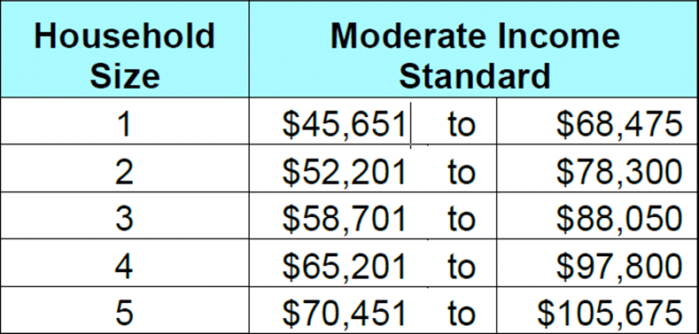
Evictions and Relocations – cont’d.
* Qualified Tenant: Senior, disabled, dependent minor child living with tenant, terminally ill.
2/5/2014

Slide 16
Harassment
RSO prohibits tenant harassment and the Legal Services Division investigates harassment complaints filed by tenants for possible criminal prosecution of the landlord
Harassment is defined as willful behavior with the intention of creating a hostile living environment or cause a reasonable tenant similarly situated to vacate the rental housing unit
A few examples of conduct that may constitute harassment:
  Threatening a tenant, by word or gesture, with physical harm
  Engaging in any act or omission which interferes with the tenant’s right to use and enjoy the rental unit
  Misrepresenting to a tenant that the tenant is required to vacate the unit
  Engaging in abusive conduct through the use of words which are offensive and inherently likely to provoke an immediate violent reaction.
  Legal Services has the ability to prosecute landlord criminally, so harassment complaint must meet that standard. Tenant may also sue in Civil Court where the standard is not as high
2/5/2014

Slide 17
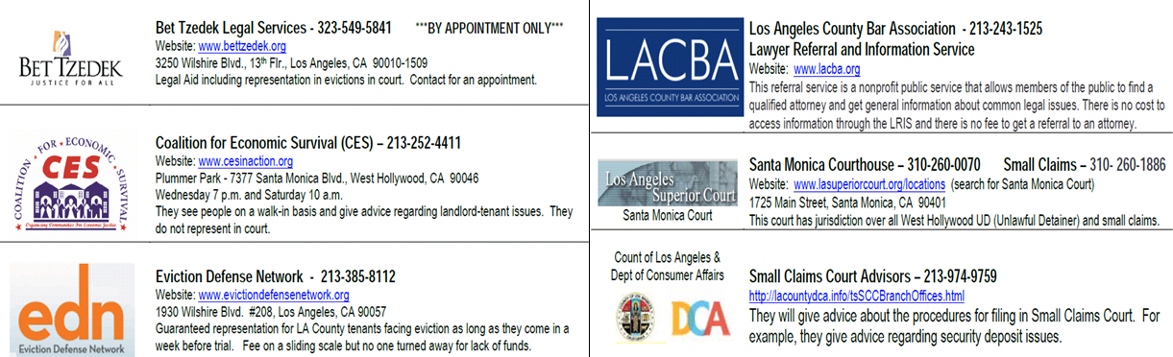
Resources
AQMD (Asbestos, etc.) (800) 288-7664
Website: http://www.aqmd.gov (909) 396-2327
City Building & Safety Dept. (323) 848-6320
City Code Compliance (323) 848-6516
Website: http://www.weho.org
Environmental Health (LA County) (213) 351-7896
Website: http://lapublichealth.org/eh/
Fire Department Non-Emergency (323) 262-2111
Prevention Bureau (Smoke Detectors) (310) 358-2380
Website: http://www.lacofd.org
Sheriff’s Department (310) 855-8850
Website: http://www.lasd.org/lasdservices.html
Vector Control (mosquitoes, rodents) (310) 915-7370
Website: http://www.lawestvector.org
2/5/2014

Slide 18
Contact Us:
Rent Stabilization and Housing Division
West Hollywood City Hall
8300 Santa Monica Boulevard
West Hollywood, California 90069
Phone: 323-848-6450
Fax: 323-848-6567
E-mail: RSD@weho.org
2/5/2014

Slide 19
Hours:
Monday thru Thursday 8 am until 5 pm
Friday 8 am until 4:30 pm
Rent Information Coordinators are available on the phone and at City Hall every Friday, including modified Fridays.
City’s Web Site: www.weho.org
2/5/2014

